Slide 1
Data Type in OOP

Slide 2
What is Data Type in C++ ?
Data type is any of the language means that what are the various type of data the variables can have in that particular language.
Information is stored in a computer memory with different type.
A variable is declared it becomes necessary to define data type that what will be the type of data that variable can hold.

Slide 3
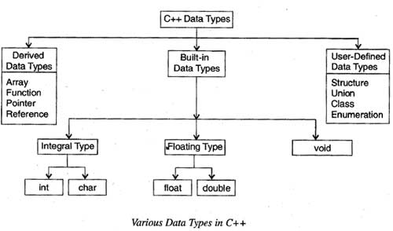
Type of Data Type

Slide 4
Continue….
There are different type of data type in c++ as-
Built-In Data Types - The basic (fundamental) data types provided by c++ are integral, floating point and void data type.
The integral and floating-point data types can be preceded by several type modifiers. The various modifiers are short, long, signed and unsigned. By default the modifier is signed.

Slide 5
Continue…..
Integral Data Type:- The integral data type is used to store integers and includes char (character) and int (integer) data types.
Char: -Characters refer to the alphabet, numbers and other characters (such as {, @, #, etc.) defined in the ASCII character set.
Int:- Numbers without the fractional part represent integer data.

Slide 6
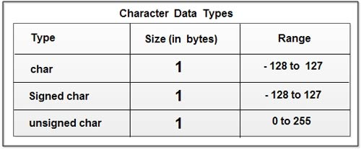
Continue…

Slide 7
Continue…
char - type for character representation which can be most efficiently processed.
Signed char - type for signed character representation.
unsigned char - type for unsigned character representation. Also used to object representations.

Slide 8
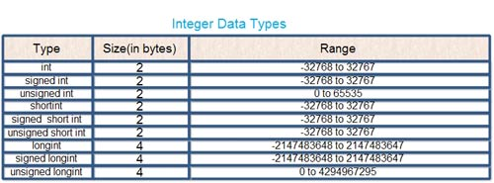
Integer Data Type

Slide 9
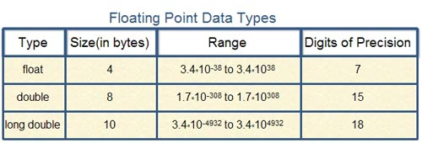
Float Data Type
A floating-point data type is used to store real numbers such as 3 .28, 64. 755765, 8.01, -24.53.

Slide 10
Void Data Type
The void data type is used for specifying an empty parameter list to a function and return type for a function. When void is used to specify an empty parameter list.
For void, no memory is allocated and hence, it cannot store anything. As a result, void cannot be used to declare simple variables.

Slide 11
Bool Data Type
The boo1data type can hold only Boolean values, that is either true or false where true represents 1 and false represents O.
It requires only one bit of storage.However, it is stored as an integer in the memory. Thus, it is also considered as an integral data type.

Slide 12
Derived Data Type
Derived Data Types- Data types that are derived from the built-in data types are known as derived data types. The various derived data types provided by C++ are arrays, junctions, references and pointers.
Array:- An array is a set of elements of the same data type that are referred to by the same name. All the elements in an array are stored at contiguous memory locations.

Slide 13
Continue…..
Function:- A function is a self-contained program segment that carries out a specific well-defined task. In C++, every program contains one or more functions which can be invoked from other parts of a program.
Reference:- A reference is an alternative name for a variable. A variable and its reference can be used interchangeably in a program as both refer to the same memory location.

Slide 14
Continue….
Pointer:- A pointer is a variable that can store the memory address of another variable. Pointers allow to use the memory dynamically.

Slide 15
User- defined Data type
Various user-defined data types provided by C++ are structures, unions, enumerations and classes.
Structure, Union :- C++ has extended the concept of structure and union by incorporating some new features in these data types to support object -oriented programming.
Class:- C++ offers a new user-defined data type known as class, which forms the basis of object-oriented programming. A class acts as a template which defines the data and functions that are included in an object of a class. Once a class has been declared, its object can be easily created.

Slide 16
Continue…
Enumeration:- An enumeration is a set of named integer constants that specify all the permissible values that can be assigned to enumeration variables.
Example- enum country {US, UN, India, China}
Declare enum type

